Slide 1
NAME : DHARSHINI R REG NO : 2428A0016
DEPARTMENT : BSc.DIGITAL AND CYBER FORENSIC SCIENCE NM-ID : asbru262428a0006
COLLEGE : SHRI NEHRU MAHA VIDYALAYA COLLEGE OF ARTS AND SCIENCE

Slide 2
PROJECT TITLE
PERSONAL PORTFOLIO WEBSITE

Slide 3

AGENDA
Problem Statement Project Overview End Users
Tools and Technologies Portfolio design and Layout
Features and Functionality Results and Screenshots Conclusion
Github Link

Slide 4
PROBLEM STATEMENT
In the modern digital era, relying only on traditional resumes is not enough to showcase an individual’s skills, projects, and achievements. Recruiters and collaborators often look for an online presence
that reflects both technical expertise and creativity. Without a personal digital space, it becomes difficult to stand out in a competitive field. To overcome this challenge, this project focuses on developing a personal portfolio website , providing an organized and professional platform to present qualifications, certifications, and projects in an easily accessible manner.

Slide 5
PROJECT OVERVIEW
The Personal Portfolio Website is developed for Almas Begam to build a strong online presence and showcase academic qualifications, technical skills, certifications, and projects. It acts as a digital resume that is easily accessible and helps recruiters and collaborators understand professional abilities at a glance. Designed with a responsive layout, the portfolio ensures smooth viewing across devices while presenting information in a clear and organized manner.

Slide 6
WHO ARE THE END USERS?
Recruiters and Employers – to evaluate skills, qualifications, and projects for job opportunities.
Peers and Collaborators – to connect for academic or professional projects
General Audience – anyone interested in learning more about the professional profile of Almas Begam.
Faculty Members and Evaluators – to assess technical knowledge and project work

Slide 7
TOOLS AND TECHNIQUES
Frontend Development:
HTML5 – for structuring the web pages.
CSS3 – for styling and layout design.
JavaScript – for interactivity and dynamic behavior.
Version Control & Hosting:
Git & GitHub – for version control and project hosting.
Design Tools:
Canva / Figma – for creating and refining UI/UX designs.
Techniques:
Responsive Web Design – ensuring compatibility across devices.
User-Centered Design – focusing on readability, accessibility, and professional presentation.
Code Optimization – clean, reusable, and well-structured code for performance

Slide 8
POTFOLIO DESIGN AND LAYOUT
The portfolio website is designed with a clean and modern layout to ensure professionalism and user-friendly navigation. The design follows a responsive web structure, making it accessible across desktops, tablets,
and mobile devices.
Home Page – A brief introduction with name, title, and a professional tagline.
About Me – Showcasing personal background, education, and career goals.
Skills – Highlighting technical and soft skills in an organized format. Projects – Displaying academic and personal projects with descriptions.
Certifications – Listing relevant certifications and achievements. Contact Section – Providing email, phone, and social media links for easy communication.

Slide 9
FEATURES AND FUNCTIONALITIES
Responsive Design – Works smoothly on desktop, tablet, and mobile.
Home & About Sections – Introduction, background, and career goals.
Skills & Projects – Showcases technical abilities and academic work. Certifications – Displays completed certifications and achievements.
Contact Section – Provides email, phone, and social media links.
Easy Navigation – Clean and user-friendly menu system.

Slide 10
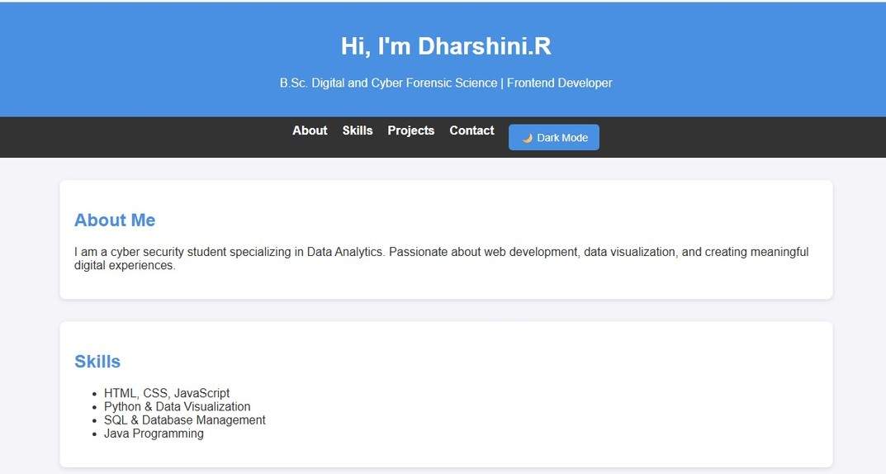
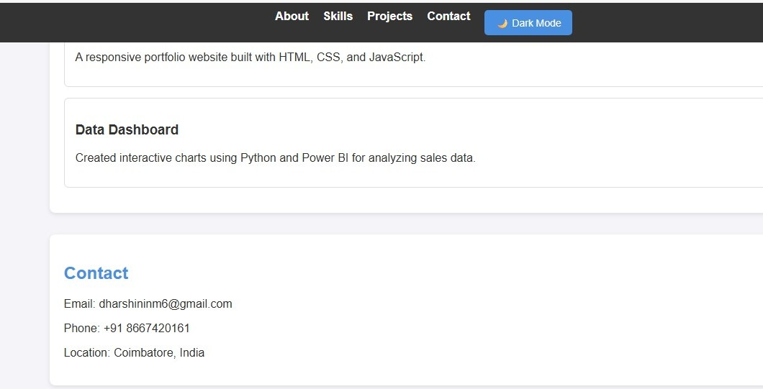
RESULTS AND SCREENSHOTS
The portfolio website effectively highlights my skills, education, projects, and achievements in a structured manner. It provides recruiters and peers with easy access to my professional details, improving visibility and networking opportunities.
The responsive design ensures a smooth viewing experience across devices, making the portfolio both practical and impactful.

Slide 11
CONCLUSION
The Personal Portfolio Website successfully provides a professional platform for Almas Begam to showcase academic achievements, technical skills, certifications, and projects in an organized manner. It serves as a digital resume, enhancing visibility and accessibility for recruiters, peers, and collaborators. With its responsive design and user- friendly layout, the portfolio strengthens personal branding and supports future career opportunities.

Slide 12
THANK YOU
+91 8667420161
dharshininm6@gmail.com
Shri Nehru Maha Vidyalaya College of Arts and Science
Thank you for taking the time to view my portfolio.
I truly appreciate your attention and support.
Looking forward to your feedback and suggestions!

